Slide 1
Velocity Campus: Customer Discovery 2
Presented by Henry Shi
@henrythe9ths
henry@henrythe9th.com

Slide 2
Introduction
Startups from My Experience
Goals and Expectations
How to Test/Validate Your Idea
How to Build a Sexy Launch Page (mini sales site)
Adwords, A/B Testing, Keyword Tips

Slide 3
Resources
Convert: Designing Web Sites to Increase Traffic and Conversion – Ben Hunt
The Definitive Guide to Adwords – Perry Marshall
Running Lean – Ash Maurya
Themeforest – Professional Designs at affordable prices
Various resources around the web
Henrythe9th.com – 14 Day Startup Challenge

Slide 4
About Me
Henry Shi
CTO, uMentioned (www.umentioned.com)
CTO, BetterU – a Next36 Company
Founder, Sendalysis – 14 Day Startup Challenge
Lend Up (YC W2014)
Machine Learning Credit Modeling
Bloomberg Sports
Statistics and Predictive Analytics for MLB
Rails Powered App, Java/C++ services
Teachings:
Learning to Code for Startup MVP @ Velocity
Student Leadership Program Facilitator

Slide 5
Agenda
Startup + Online Market
Build a Launch Page
Test/Evaluate Market using AdWords
A/B Testing

Slide 6
Questions?

Slide 7
Startups
Why do Startups Fail?

Slide 8
Why do Startups Fail?
Building Something that No One wants
“Life is too short to keep building something nobody (or not enough people) want” – Ash Maurya
Given time and resources, we can build our solution to spec, but it is the market that is both the riskiest and most unforgiving to startups
The biggest risk of a startup is not failing, but wasting years of your life with an idea that will go nowhere

Slide 9
Example: Review Site for Mechanics
Car Mechanic industry is broken:
very low transparency
high commissions
high variability in service quality
many poor experiences
long waiting time
over budget services
Ripe for disruption with our fancy Web 2.0 app?
Make revenue on affiliate, sponsored ads, etc

Slide 10
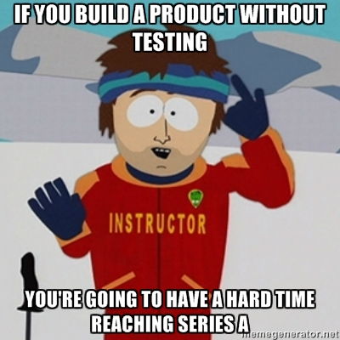
Wrong

Slide 11
Wrong – Until we validate our hypotheses
What are our hypotheses?
Do people have a problem with their current mechanic?
Maybe I’ve been visiting my neighborhood mechanic for the past 20yrs
Who are the target demographics for dissatisfied car owners?
Do they use the internet for opinons/review?
Are they likely to post reviews?
What do people care about when they see a car mechanic?
Price, Speed, Quality, Experience, Convenience?
Do I see a mechanic often enough to care?

Slide 12
Product Meets Market
What is the core problem?
Most, if not all of your assumptions will be proven totally or partially incorrect when you put your product to the market
Why waste months of your life and thousands of dollars building something that doesn’t solve a (painful enough) problem?
Ideas are cheap, your life isn’t

Slide 13
Startups
Startup is a business != side project
Funnel of Demand
People who like your product
People who would use your product
People who actually use your product
People who would pay for your product
People who actually pay for your product
People who pay for your product now
People who have paid you
People who continue to pay you

Slide 14
Reduce Market Risk
This session is to help you reduce your market risks as much as possible
Test, validate/invalidate as many market risks as possible before writing a single line of code
Secure prepayment before the product is finished
Self fund your startup
Negotiate better terms with investors, early employees
sleep better at night ☺
Evaluating Demand for Your Idea

Slide 15
Lean Startup
Won’t be covered in this session
Lean Methodology – Eric Reas
Theory and concept, but not helpful in application
Running Lean – Ash Maurya
Best book I’ve read about startups
Step by step process for executing the lean methodology
henrythe9th.com
I blogged the everyday, step-by-step process of starting a startup from scratch in 14 days

Slide 16
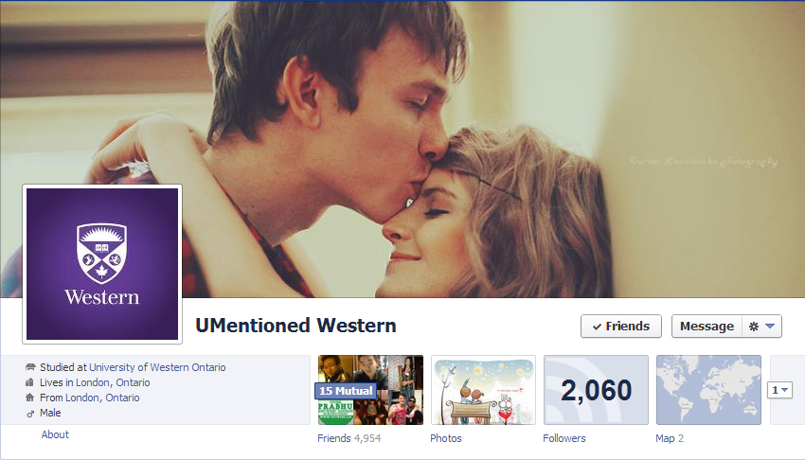
Bootstrapping to 30K Users
uMentioned
0 lines of code in production
100% self funded and bootstrapped
Reached over 20 schools across Canada

Slide 17
Reducing Market Risk: 0 Lines of Code
uMentioned
0 lines of code in production
100% self funded and bootstrapped
Reached over 20 schools across Canada
Successfully validated core value proposition of anonymous social interactions
Significantly reduced market risk

Slide 18
Building a Launch Page
What is the purpose of a launch page?
What should be on the launch page?
When should you put up a launch page?
What are my options for building/hosting a launch page?

Slide 19
Launch Page - Purpose
Mini (Fake) Sales Site – Lean Principle
Pretend that you have a working product/ service fully built, with screenshots, pricing, quotes, signup, etc
Watch behavior of real website visitors as they click through your website, browse, and signup, try or buy

Slide 20
Launch Page – Purpose
Asking people if they’d use your product is inherently biased
Only way to find out for sure if people would use your product is if they think they are really trying or buying it when they visit your sales site
Every time someone clicks try or buy, you record that action, and notify that your product is still under development, and ask for their email
Track your conversion metrics too see if there’s enough demand (more on this later)

Slide 21
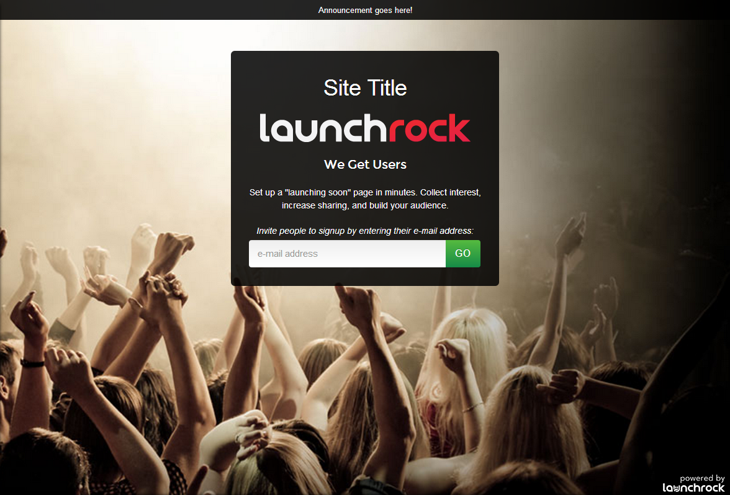
Launch Page – Bad Example

Slide 22
Launch Page – What to include
Mini Sales site should have (only) the following:
Home
Product Tour/ Screenshots (optional)
*Pricing*
Signup
Home page should have a list of features, and a Call to Action to Try/Buy

Slide 23
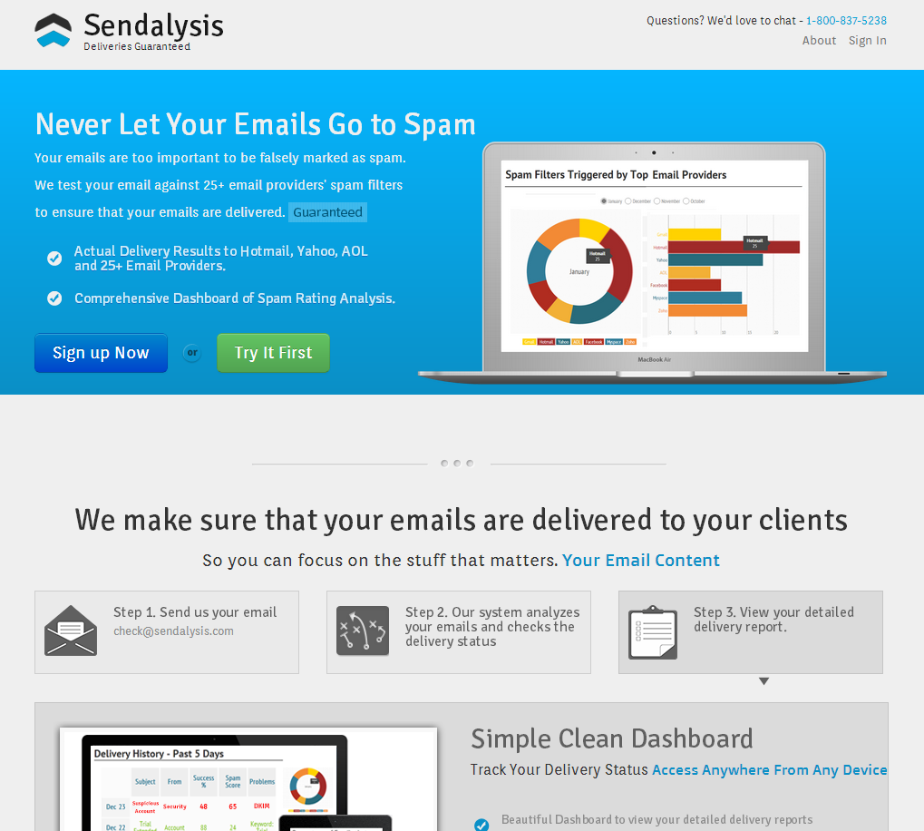
Launch Page - www.sendalysis.com
Clear CTA
Tracking on
every action,
event, click,
scroll, visit
duration, etc
Fake reports,
graphic, icons…
Manual reports

Slide 24
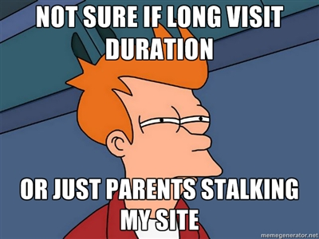
Launch Page – What to include
Analytics Tracking Tools
CRITICAL!!!

Slide 25
Launch Page – Tracking Tools
Won’t go into details of landing page metrics and optimization here
In essence:
profit = traffic * conversion
Monitor some key metrics:
Bounce Rate
Visit Duration
Pages/Visitor
Inbound Traffic Referrals
% new vs returning visitors

Slide 26
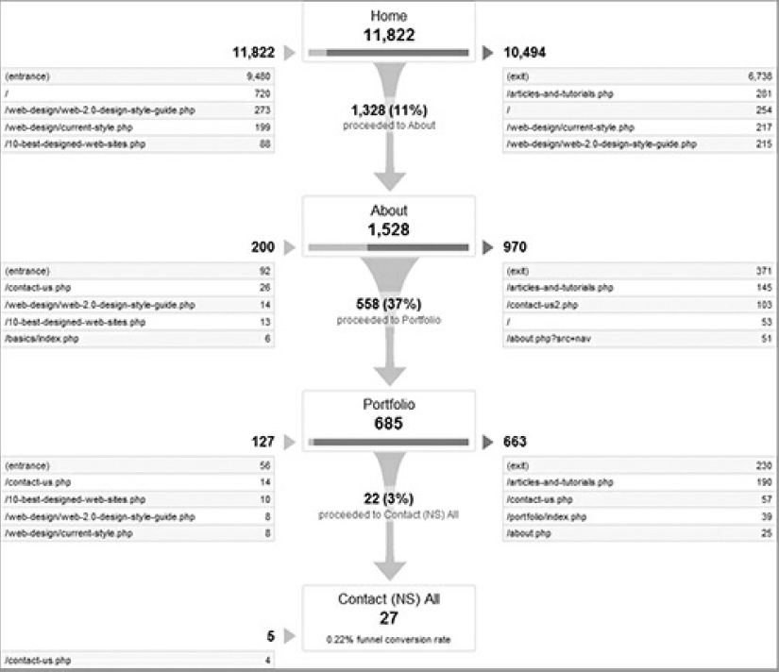
Launch Page – Conversion Funnel
Group Visitors into Cohorts if possible

Slide 27
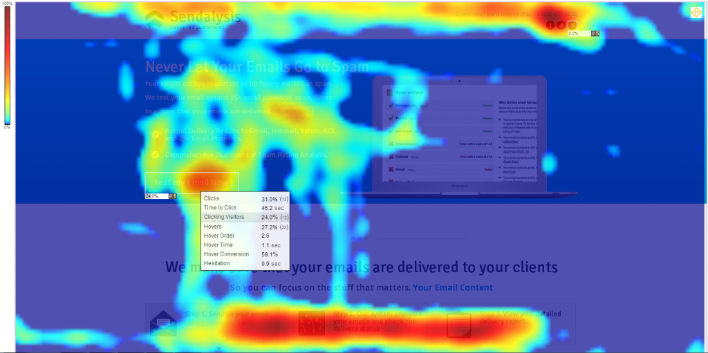
Launch Page – Events Tracking
Tracking Individual events will tell you so much more than just Google Analytics

Slide 28
Launch Page – Analytics Tools
Google Analytics
King of Analytics. No site should be on the internet without it.
Can be used for simple pageview and referral tracking or complex event based tracking
Clicktale
Great screen recording tool
Records the user’s mouse movements, clicks, scrolls
Can view recorded browsing sessions, as well as heatmaps of mouse movements/clicks
Woopra
Very powerful real time analytics
Great for real time stats and funnel analysis
Mixpanel
Advanced event based tracking tool
Has a Free tier but I didn’t bother writing JavaScript code to track every event.
ClickDesk
A live help chat tool that’s free for 1 operator
Clickdesk integrates with your GChat/Gmail or Skype, so you can chat to your website visitors on GChat or Skype!
All have very powerful Free Tier

Slide 29
Launch Page – When to put it up?
When you have a set of core value propositions that you want to test
Put up a launch page to test if your value propositions are solving a real, pain point
Make sure to define falsible hypotheses before deciding what to put on the landing page
Make sure your landing page is testing those hypotheses and record results following a scientific method

Slide 30
Launch Page – What about Stealth?
Life’s too short to be building something that no one (not enough people) want
Have a brilliant stealth idea? Try calling your competitor’s engineering department about your idea and try to make them take your idea and build it

Slide 31
Launch Page – What about Design?
Any fisherman will tell you that the best rod and bait in the world won’t do you any good in a mud puddle
A Good market beats content, copy and design any day.
Even the best design won’t save you from a rough market. Eg. Wunderkit

Slide 32
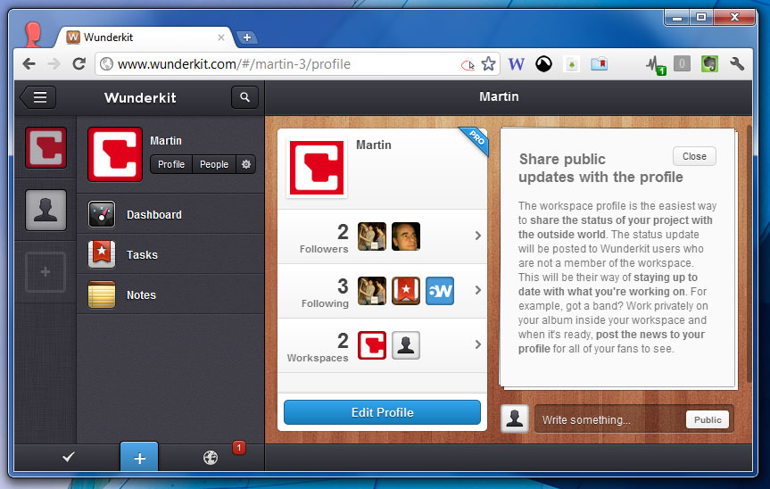
Launch Page – What about Design?

Slide 33
Launch Page – Building/Hosting
Depends on your skillset and timeframe
Unless you are a designer, highly recommended to use a template or template
Themeforest.com has thousands of amazing landing page templates for $10-$15

Slide 34
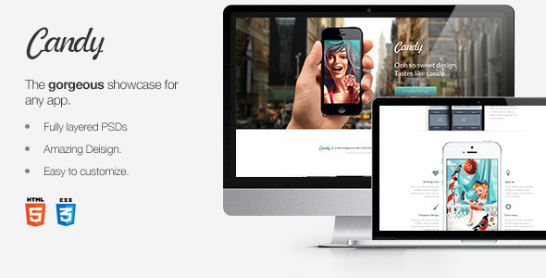
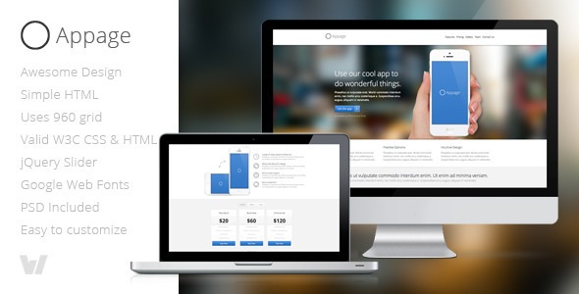
Themeforest – Examples

Slide 35
Launch Page - Hosting
Doesn’t really matter
Launchrock.com is great for simple sign up pages, but too inflexible for the home page
Ramnode VPS
2CPU, 512MB Ram, 60GB HD + SSD Cache, 2TB bandwitdh for $5~/month
Extremely flexible and cheap
http://serverbear.com/ for all-in-one comparison of hosting solutions

Slide 36
Questions?
http://henrythe9th.com/resources/how-to-build-a-killer-landing-page/

Slide 37
Testing and Evaluating a Market
How do we gauge the market demand for our product/service?
How do we access potential customers outside of our geographic confinements?
How do we study the characteristic and demographics and behaviour of our target market?
The Internet!

Slide 38
AdWords
Variety of Ad Networks, display ads, video ads, etc, but we’ll focus on Google’s text search ads
From Wikipedia:
Google AdWords is Google's main advertising product and main source of revenue. Google's total advertising revenues were USD$42.5 billion in 2012

Slide 39
Adwords
Why Adwords:
No Minimum investment
unlike most advertising
Can target very specific niches
Location, demographics, time of day
Can be turned on/off instantly
Relatively inexpensive
Simple and fast turnaround time
Customers who search as actively looking for a solution

Slide 40
AdWords: Assessing Market Health
View past search volume and cost to assess market health
Avoid too competitive markets and markets that have no volume
www.askhowie.com/mpg
www.spyfu.com
Google AdWords’ Keyword tool

Slide 41
AdWords MPG – Example
Walkthrough of assessing market health using MPG tool

Slide 42
AdWords – Creating Your Campaign
Make sure to use Google’s $100 credit for $25 spent on AdWords coupon when you sign up
Sample coupon codes ☺
3d6t3-uftd9-aj3p 9coan-janag-dvdq 7dgfh-d33q4-vtf6 cj4mt-9ehxw-mrxj
9vx9w-matl6-hnyh auqnr-utgy4-fyhh

Slide 43
AdWords – Creating Your Campaign
Fundamental Rule is Relevance
High relevance between your keywords and your ad
High relevance between your ad and your site content
You will be rewarded by high relevance, punished by low relevance

Slide 44
AdWords - Relevance
Your Relative Position = (Your Bid Price) x (Your Clickthrough Rate)
Showing highly relevant ads will increase your click rate, and help drive down your costs.
For example, if I can increase my clickrates from 1% to 2%, then I can only bid $0.5 on an ad that would have otherwise cost me $1
Echo Your Customer’s Inner Voice
Offer your customer precisely what he’s looking for as soon as he arrives
Make sure your ad precisely matches your keyword and you content matches your ad.
You will likely need different ads for different keywords and even different urls, content pages for different ads (more on this later)

Slide 45
AdWords – Keyword Research
Identify attractive target keywords for your web pages
Keywords are terms (single words or phrases) that you want your page to appear to be about
Three important criteria of keywords:
1. High relevance
2. High traffic
3. Low competition

Slide 46
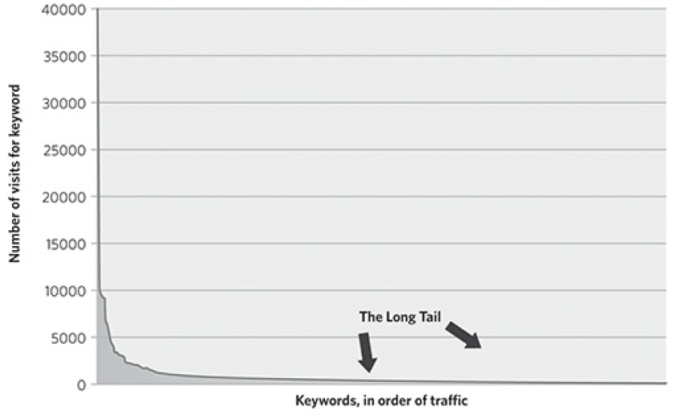
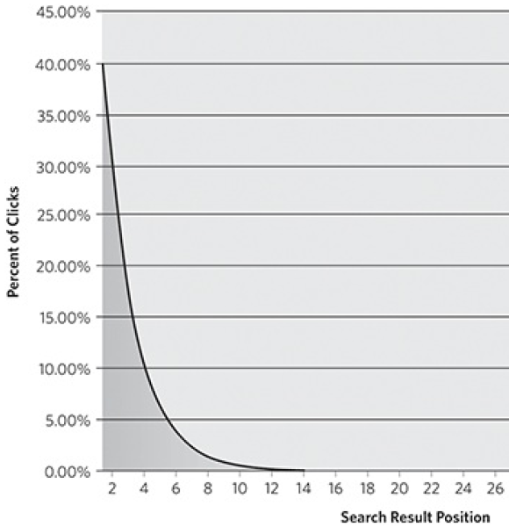
AdWords – Keyword Research
You have to rank high, within the 1-3 ranked ads
Strategy is to target specific “long-tailed” keywords

Slide 47
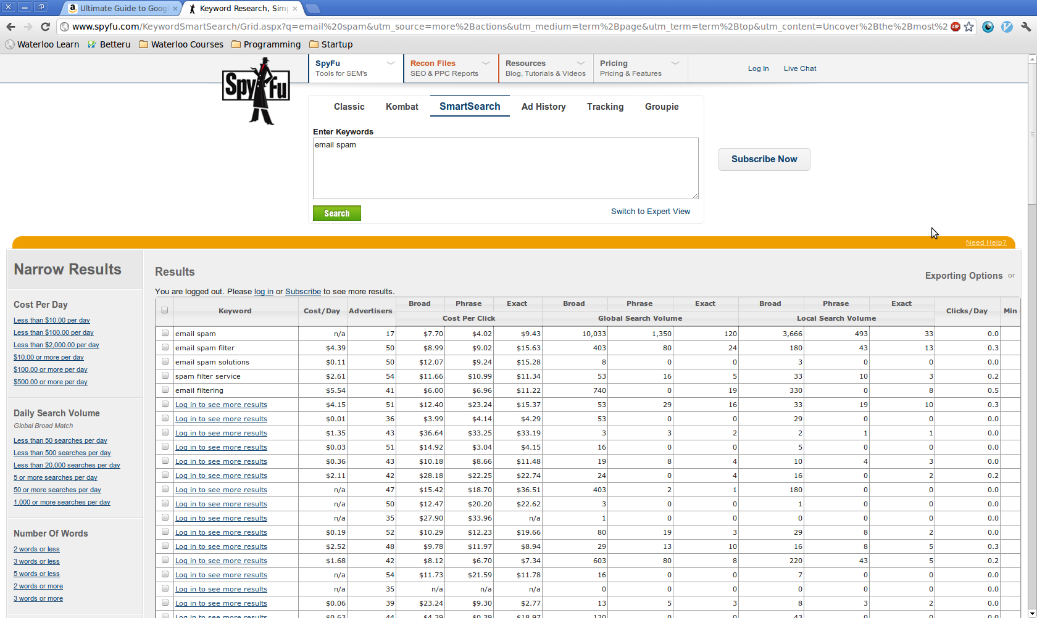
AdWord – Keyword Research
Start with your general topic, then use free or paid tools to help generate more keywords

Slide 48
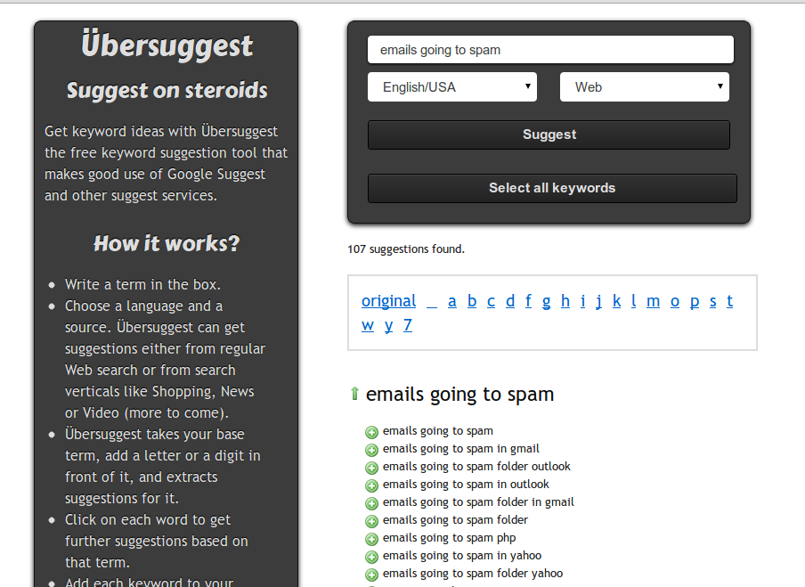
AdWords – Keyword Research
Best free tool is ubersuggest.org, based off of Google’s own auto suggests

Slide 49
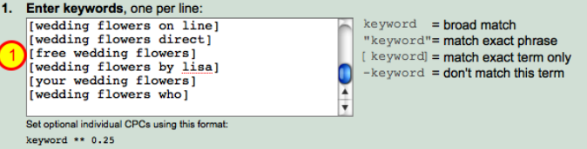
AdWords - Keywords
Make sure to prevent Google from auto matching broader keywords by putting quotes around all your keywords (increase relevance)
Make sure to include a list of negative keywords to prevent matching similar, but distinct markets

Slide 50
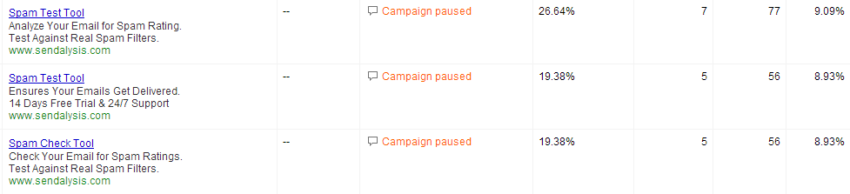
AdWords – Creating the Ad
Writing Good Copy
Beyond the scope of this session
Keep relevance at the top of your mind
Input keywords
Set Max CPC bid, max budget/day

Slide 51
AdWords - Conclusions
Profit?
In the long run, Adwords is a poor strategy for sustained growth
Eg, 1% conversion rate, need 100 visits/sale, $1/visit = $100 to acquire customer
Better to use inbound marketing, blogging, organic growth, SEO, etc

Slide 52
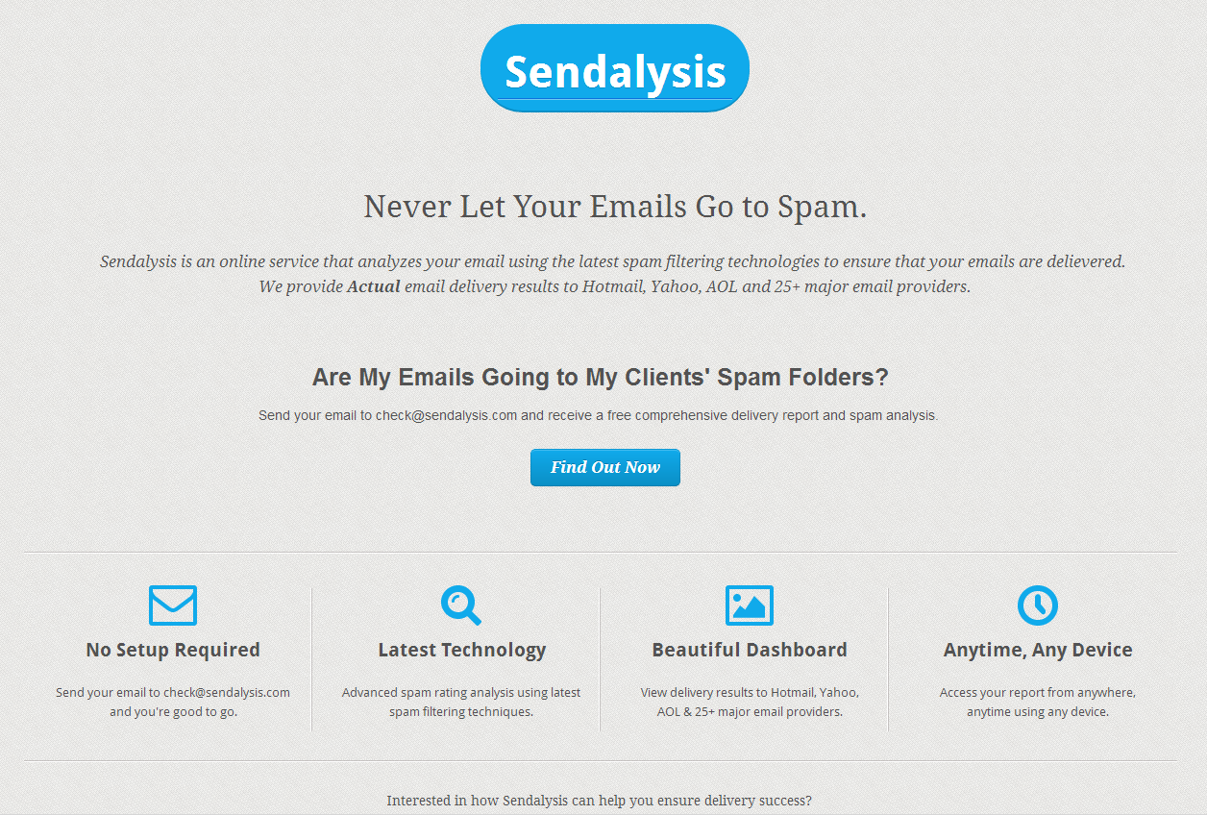


Split Test
All about the Scientific Method
A vs B, which is better?

Slide 53
Split Test
Always A/B test your Ads, landing pages, copy, etc
Switch out the poorer performing one for a new test
Continuous improvements

Slide 54
Split Test - Tools
Many tools to help automate A/B Tests
https://www.optimizely.com/
http://visualwebsiteoptimizer.com/
Google Analytics Content Analytics (free)

Slide 55
Split Test - Results
Simple Landing page 10x effective:
36% Signup rate vs 0% previously
27.5% usage rate (sent email to check for spam) vs 5.4% previously
Spam Test Tool AdWord much more effective
9.09% avg CTR vs 4.88% CTR of other Ad

Slide 56
Questions?
henry@henrythe9th.com
@henrythe9ths
henrythe9th.com

